Slide 1
Office 365 Development

Slide 2

Agenda
Intro
Office 365 App Model
Office 365 APIs
Tools
Development Environment 365
Development Environment On-Prem
Resources

Slide 3
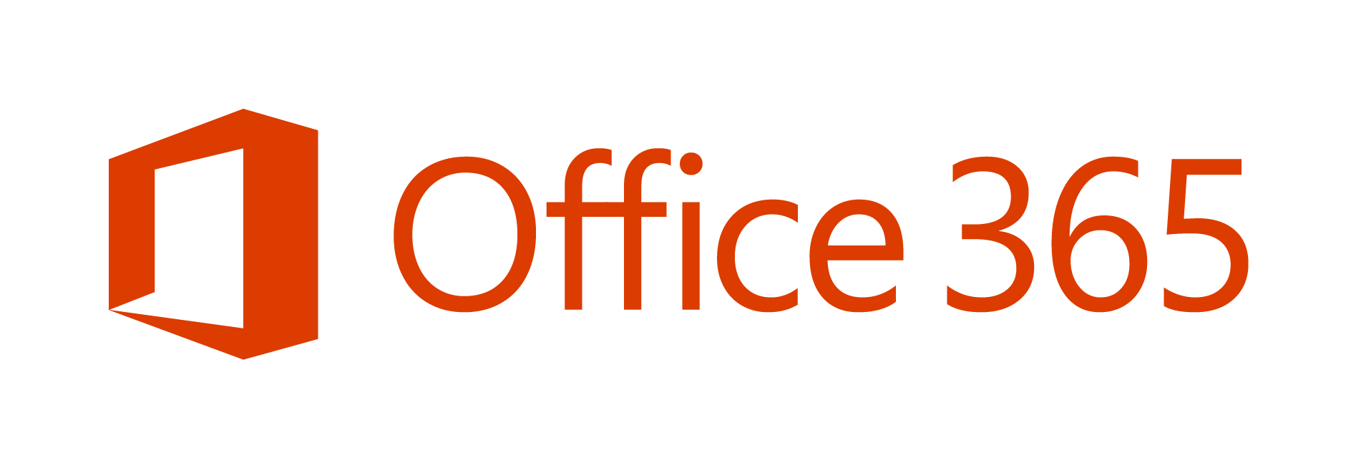
is one of the fastest growing businesses
in Microsoft history.
Notes:
1 billion people use Office – 1 in 7 people on the planet.
Office 365 is Microsoft’s fastest growing commercial product ever
Office 365 Home and Personal total more than 5.6 million subscribers, adding over 1 million subscribers again this quarter (Q4 FY14).
Commercial cloud revenue grew 147%
Annualized run rate that exceeds $4.4 billion (in Q4 FY14).
20 consecutive quarters of triple-digit customer growth Y/Y, since launch in FY09 (Q4 FY14)
35 million downloads of Office for iPad (Q4 FY14).
Over 50% of Office 365 revenue comes from international markets
Office 365 commercial seat growth in emerging markets of 162% Y/Y (Q4, FY14)
Office 365 commercial seats nearly doubled, 99% Y/Y (Q4, FY14)
Nearly 50% of Exchange licenses purchased in Q4 were cloud licenses, and 30% of the Exchange annuity installed base is now in the cloud. (For Q4, FY14)
24% of the Exchange installed base is now on Office 365, up 11pts Y/Y (Q4, FY14)
Yammer is used by more than 500,000 organizations (Q4, FY14 - WPC)
Over 40% of Office EA renewal licenses were in the cloud, up from 10% last year
Over 80% of enterprise customers have more than 1 workload
70% of Fortune 500 companies have purchased Office 365 in the last 12 months
7 out of 10 Fortune 500 Manufacturing companies have a Microsoft cloud enterprise service.
6 out of 10 Fortune 500 Financial Services companies have a Microsoft cloud enterprise service.
SMB partners transacting over the trailing 12 months grew over 2x Y/Y (Q4, FY14)

Slide 4

"The most strategic developer surface area for us is Office 365“ - Satya Nadella
Notes:
Why?
The key to enterprise productivity going forward
Microsoft’s strategic advantage in the Enterprise
Partners and Developers are key to its success

Slide 5


Where are we?
FY13
FY14
FY15
Feb 2013
Momentum
Today
Launched Office 365
Over
apps paid
Extend Office across endpoints
1200
apps
Target
More than
all
3,400,000
with over
millions
worldwide devs & partners
142+
Office + SharePoint developers
installs
Expand REST APIs
New markets opening March 2013
400+
Open platform existing solutions
Petabytes of data in Office 365 (March 2014)

Slide 6
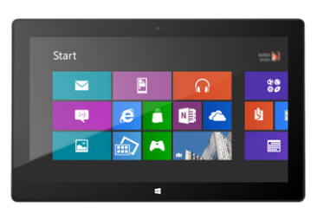

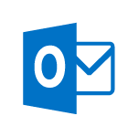

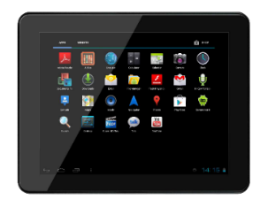
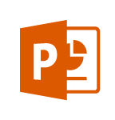
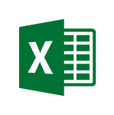
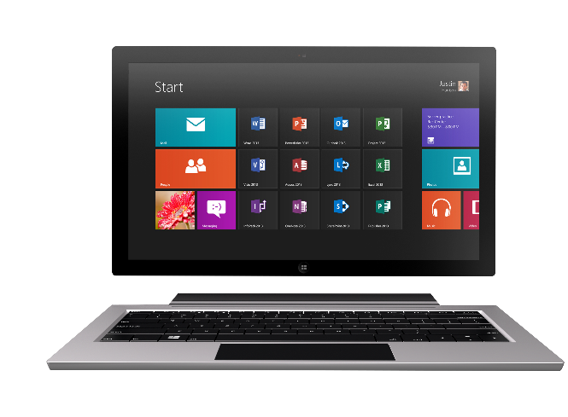
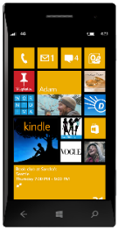

Technology journey
PC
1990s
PC + Servers
2000s
Devices + Cloud
2010s
VBA
VBA
Com add-ins
VSTO
Open standards (OAuth, REST, etc.)
Mobile SDK’s
Notes:
Technology Journey
Respect for the investments that you’ve already made
Reaching out to a whole new world of possible.

Slide 7
The Opportunity
Mobile Devices
1.2B in 2014
1.8B in 2018
1B+
400+ PB
2-3 hours/day in Office Apps
Notes:
Why should you care?
Office 365 is the fastest growing commercial product in MS history
SharePoint used to hold this crown
SP commanded a $7B partner revenue attach
Office development is another Socket to attach to jump on that train!
Why?
Business Users, Consumers all use Office
Office is the universal language of productivity
1B+ Users
1.2 – 1.8B mobile devices in the next 4 years
2-3 hours in Office a day
400+ Petabytes of data
Valuable business data!
Office lets you move across the stack
SMB <-> EPG

Slide 8
Office 365 is a rich platform ripe for extending and integrating with.

Slide 9
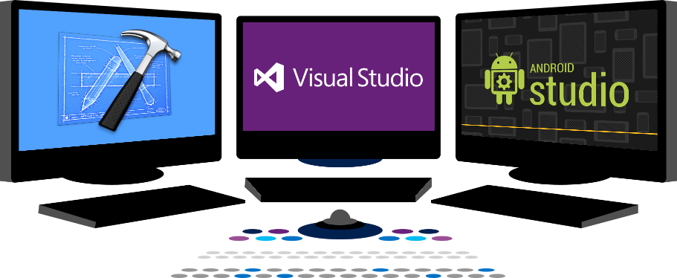

Vision
EXTEND OFFICE EVERYWHERE
CONNECT TO OFFICE 365 SERVICES
BUILD USING AN OPEN PLATFORM
dev.office.com

Slide 10













Vision
EXTEND OFFICE EVERYWHERE
CONNECT TO OFFICE 365 SERVICES
BUILD USING AN OPEN PLATFORM
Delve
z
Users and groups
Files
Mail
Calendar
My Apps
Video Portal
Contacts
Office Graph
Presentations
Documents
Spreadsheets
Lync
OneNote
Yammer

Slide 11
Office 365 App Model
Office 365 Development Overview

Slide 12
App Model Redux
PRINCIPLES
Designed for openness and flexibility
Enabling a consistent development platform
Powering a world of devices
TIGHTLY BOUND
LOOSELY COUPLED
Host process
Solution host
Productivity service
O365 APIs and Office.js
Solution
Solution
Platform
Platform
Notes:
App Model Redux
Why we do what we do
It’s not just about the cloud
Framework how we think about going forward.

Slide 13
What’s New
EXTEND OFFICE EVERYWHERE
CONNECT TO OFFICE 365 SERVICES
BUILD USING AN OPEN PLATFORM
My Apps
Users and groups

Slide 14
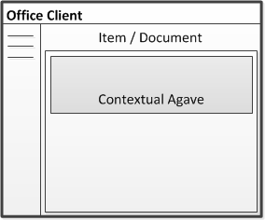
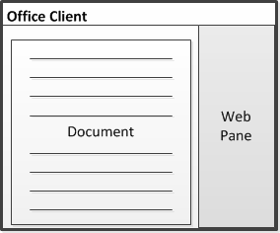
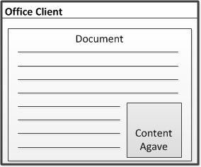
Apps for Office (Outlook, Word, Excel, PowerPoint) A new way to build extensions for Office
Outlook, Outlook Web Access
In context of mail, calendar items, people card
Contextual pane
Word, Excel, PowerPoint, Project
Task pane area with read/write access to document contents
Task pane
Excel, PowerPoint
App runs within a documents content
Embedded content

Slide 15
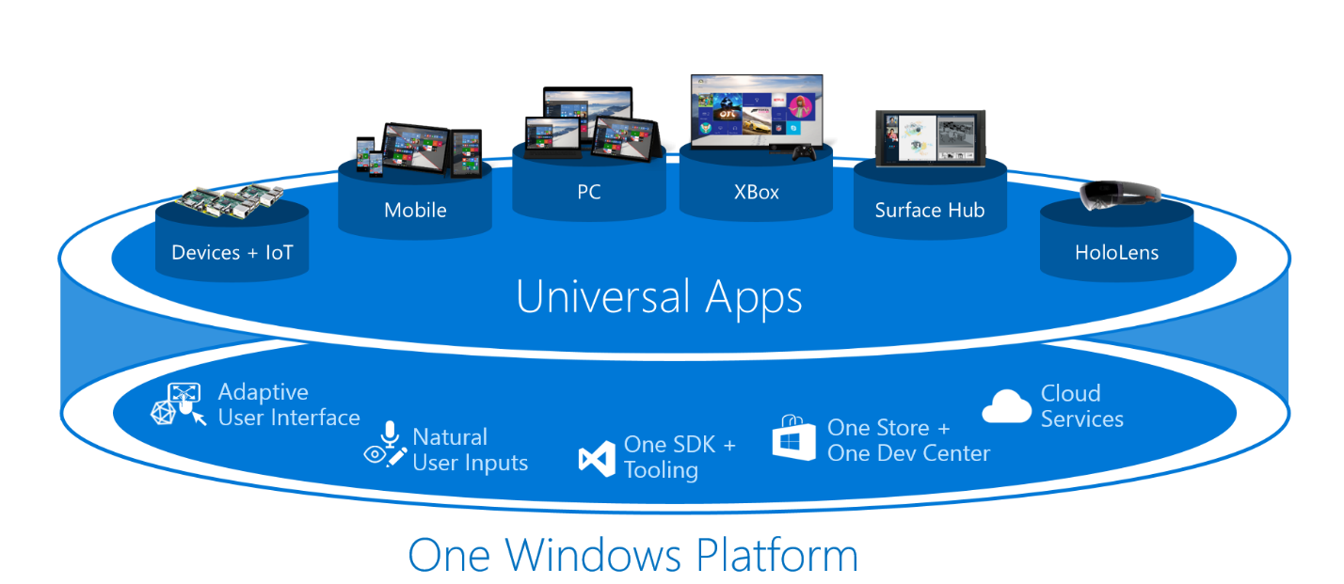
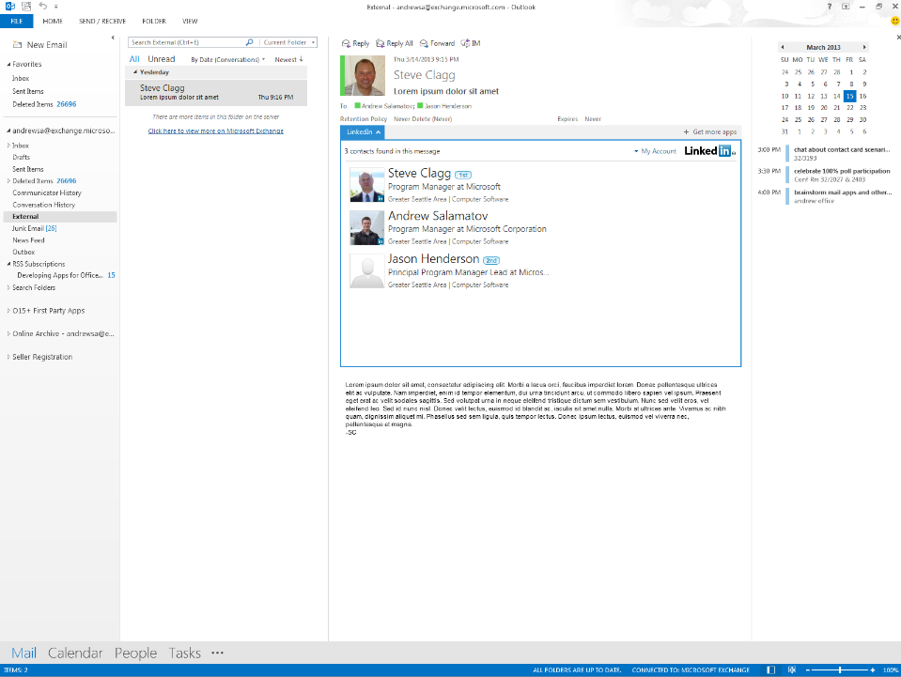
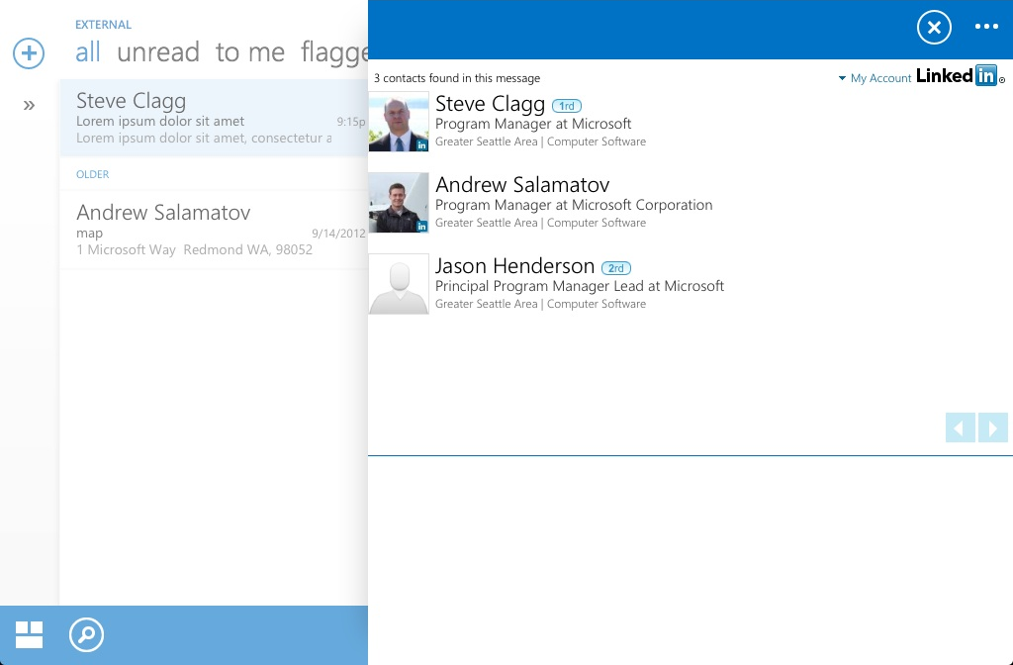
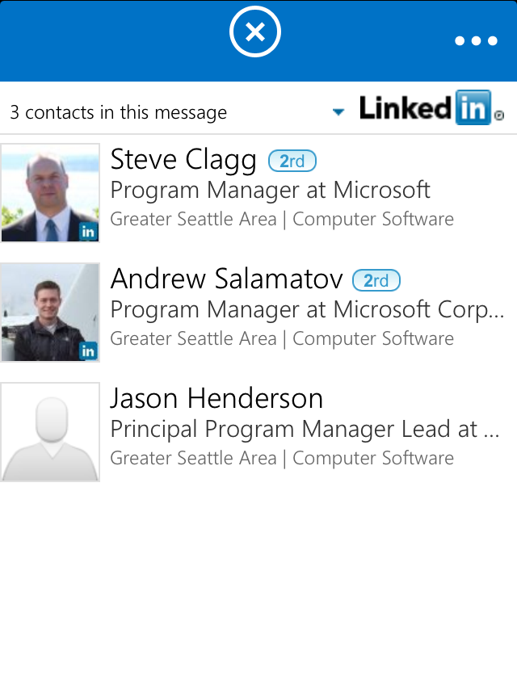
Mobile friendly Write once, run everywhere (Universal Apps Win 10)
Desktop and Web
Tablet
Phone

Slide 16
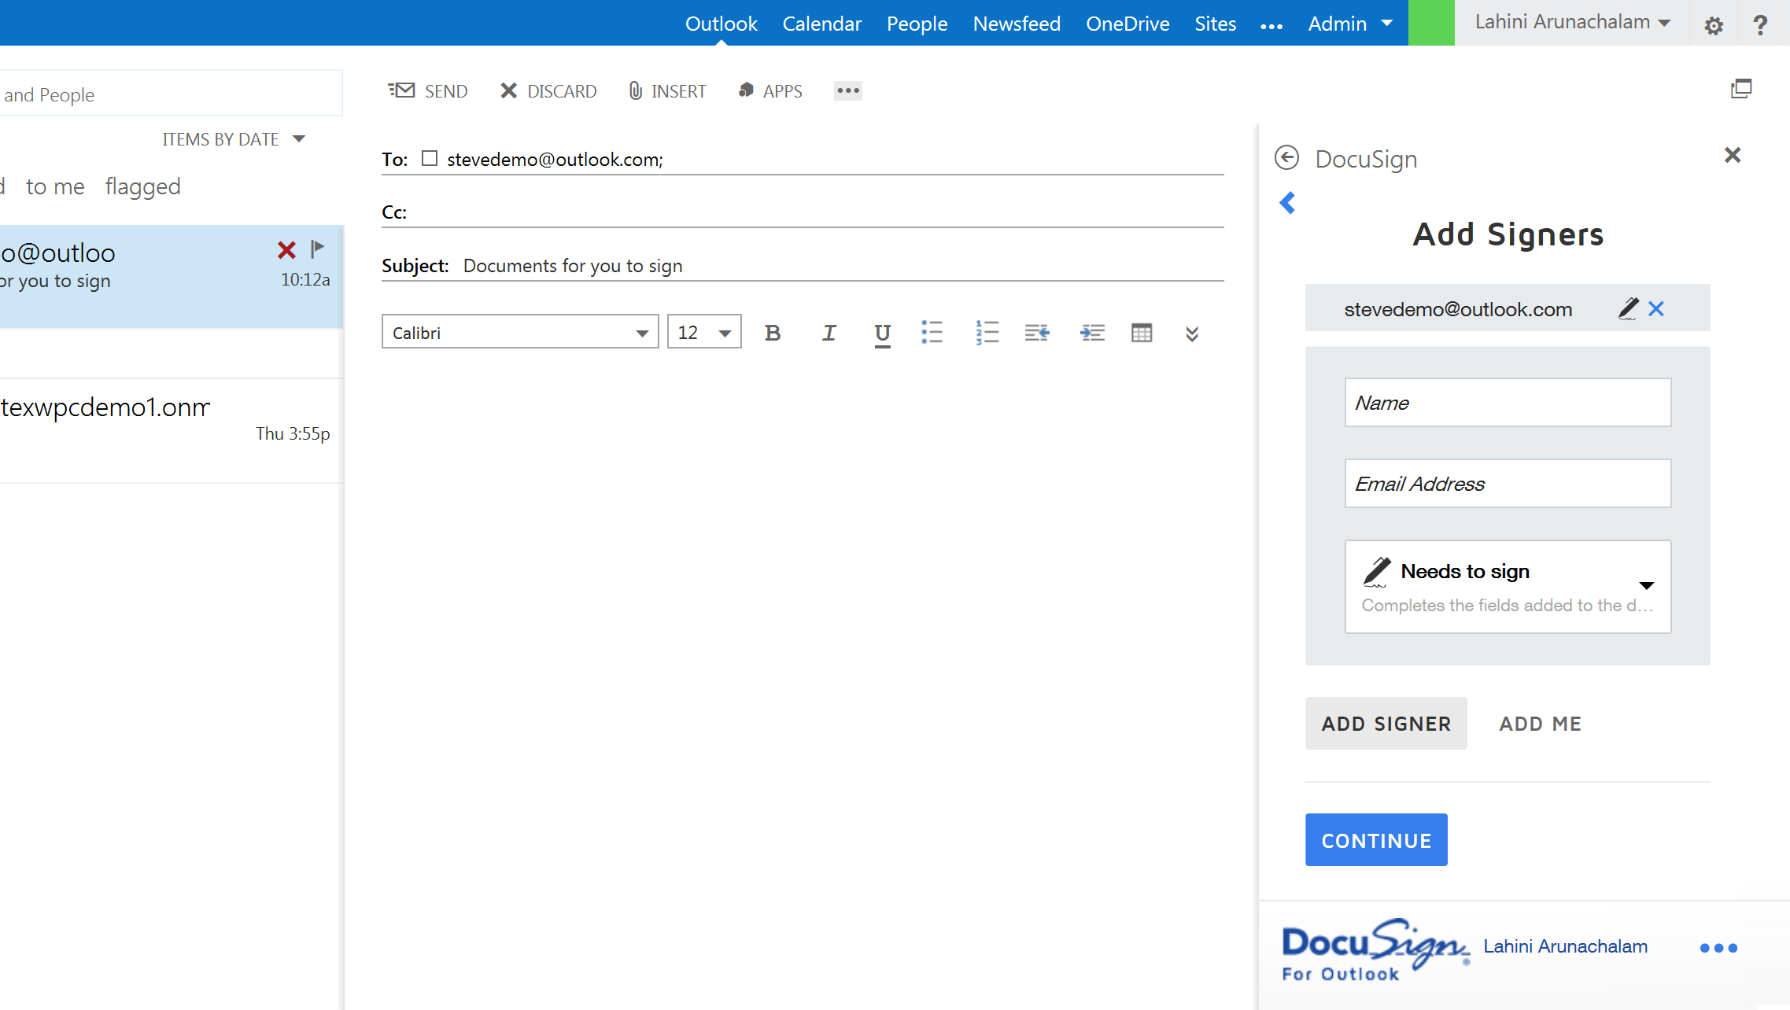
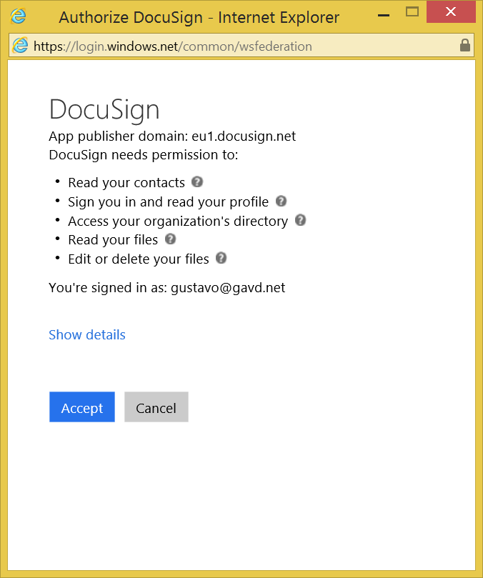

Slide 17
Demo

Slide 18
Apps for SharePoint
Full Page
Implement complete app experiences to satisfy business scenarios
App Parts
Create app parts that can interact with the SharePoint experience
UI Command Extensions
Add new commands to the ribbon and item menus

Slide 19
The SharePoint client APIs
Sites, Lists and Libs
Workflow
Search
Taxonomy
BCS
…
_api
Execute query
REST/ OData
JavaScript library
Silverlight library
.Net CLR library
Custom client code

Slide 20
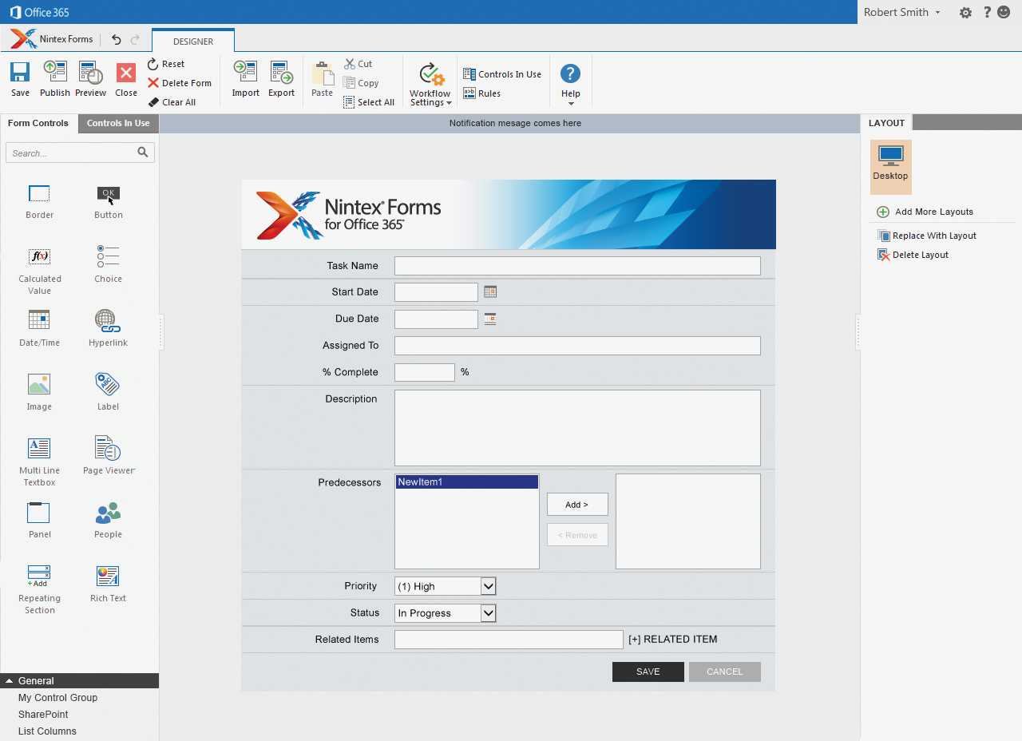
Full Page Connected App Provider Hosted in Azure

Slide 21
Demo

Slide 22

Office 365 API
Simple REST/OData APIs
Versioned
Expose Files, Sites, Mail, Calendar and Users
AuthN/AuthZ via Azure AD and OAuth
Users and groups
Files
Mail
Calendar
Contacts

Slide 23
Robust Office 365 APIs
Designed for openness and flexibility
Enabling a consistent development platform
Powering a world of devices
https://api.office.com/discovery/me
Documents
Mail
Calendar
People
Search
Social
iOS
dev.office.com

Slide 24
Office 365 APIs
Active Directory
Exchange & Outlook.com
SharePoint
OneDrive
Sites
OneDrive
Users
Mail
Calendar
Client API
OneDrive for Business
Sites, Lists and Libs
Taxonomy
Groups
Contacts
Workflow
BCS
Search
…

Slide 25

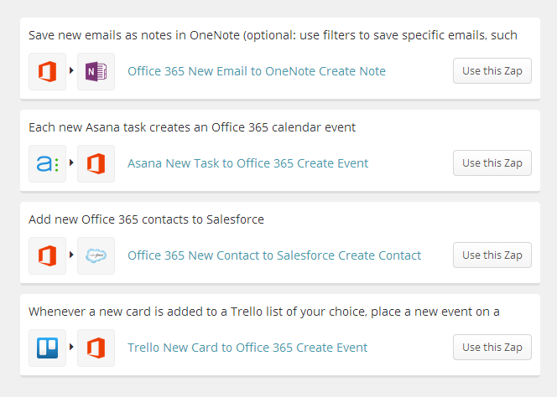
Office 365 services for Apps
https://zapier.com/zapbook/office-365/
(Zapier, Heroku, IFTTT, etc.)

Slide 26
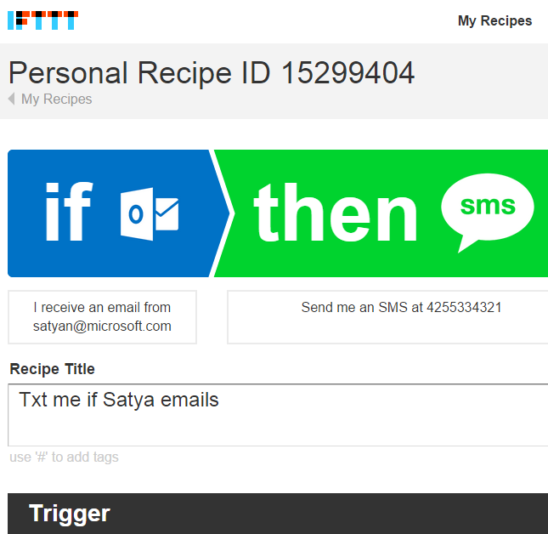
IFTTT
18mil recipes run a day
140 channels
17mil personal recipes
50mil channel activations

Slide 27

App Model Development
If you know general web development, you also know Office 365 development…
Notes:
Same code works in cloud and in on-premises
Build market place apps and reach all Office 365 customers easily
More flexible model with additional possibilities
Standard .NET development tooling

Slide 28
Benefits of the new app model
Safe and robust
App code runs outside of Office … with clear security boundaries
Clearly defined API build on modern standards
Device friendly
Apps run in the full Office client apps
Works on Tablets and Phones
Modern development
Build Apps for Office using modern development tools and technologies (VS)
Robust APIs in Office and Office 365
Flexible tools such as HTML5, Azure and Visual Studio
Notes:
Take away
Make smaller changes - ripples - rather than big, disruptive wave changes.
Key talking point - “No more hotfixes, service packs, or major upgrades. Office 365 ProPlus can be the last Office client you’ll ever deploy.”
Some customers have expressed concern regarding the inclusion of security update and non-security updates in the monthly Office 365 ProPlus updates, and the frequency with which those updates might be released.
O365 ProPlus Servicing
In a services world, we are constantly providing small, incremental enhancements to the security and value of our Office 365 services, including Office 365 ProPlus.
Each month, a new build of Office 365 ProPlus may be released in the cloud. Each monthly build may contain security updates, non-security updates, and functionality improvements.
Updates are cumulative, so each build contains all the other changes from previous builds, however only the difference- or delta- between the new build and the existing one is installed.
Deltas are downloaded in the background and applied when Office apps are not running (or upon reboot).
Some examples of the non-security value in monthly updates:
Changing the Lync Icon on the Task bar to show presence (October, 2013)
Adding spell check into the Lync client (October 2013)
Changing “Enable updates” to “Apply Updates” (Feb 2014)
PowerMap Add-in for Excel (Feb 2014)
Traditional Model (MSI)
Any software update involves changing code, regardless of the type of update, and so there is the same inherent risk when applying updates.
The traditional method of on-prem deployment (where there are 1 or more security updates and 1 or more non-security updates per month) provides the ability for IT groups to deploy certain types of change in their environment without testing (ie, security updates), and reject or delay other changes that may require more testing. But this provides the illusion of control since they can’t see what code has been changed. So this approach really means “I’m OK with deploying code changes in my environment, but I’m NOT OK with deploying code changes in my environment.”
Change Management and Risk Control
When managed properly, the new update model actually reduces your risk…and it significantly reduces your testing efforts. Meaning, if you are an organization that performs testing of Office updates prior to distributing them to your end-users, then you’re going to perform the same testing regardless of what’s inside the update, security or non-security.
This provides IT groups the ability to leverage a single process to manage change in their environment, regardless of what the change is. Having fewer processes to manage makes introducing change more consistent, increases your ability to automate such processes, and greatly reduces your risk that comes with managing variance in your IT environment. One approach is to deploy a new build to a pilot audience.
Use Telemetry to provide objective data regarding usage or issues that arise for users with the new build. This will help provide an evidence-based approach to determining “does this build work for me?”

Slide 29
.NET SDK
ASP.NET MVC
ASP.NET WebForms
WPF

Slide 30

Cross platform
ASP.NET MVC
ASP.NET WebForms
WPF

Slide 31
Native
ASP.NET MVC
ASP.NET WebForms
WPF

Slide 32


Distribution choices
Office Store
App Catalog
Notes:
Lifecycle
Not just the store
Momuntem has been building store and on-prem
Store features ; subscriptions
Business-ready
Corporate catalog
Training users to get new experiences

Slide 33
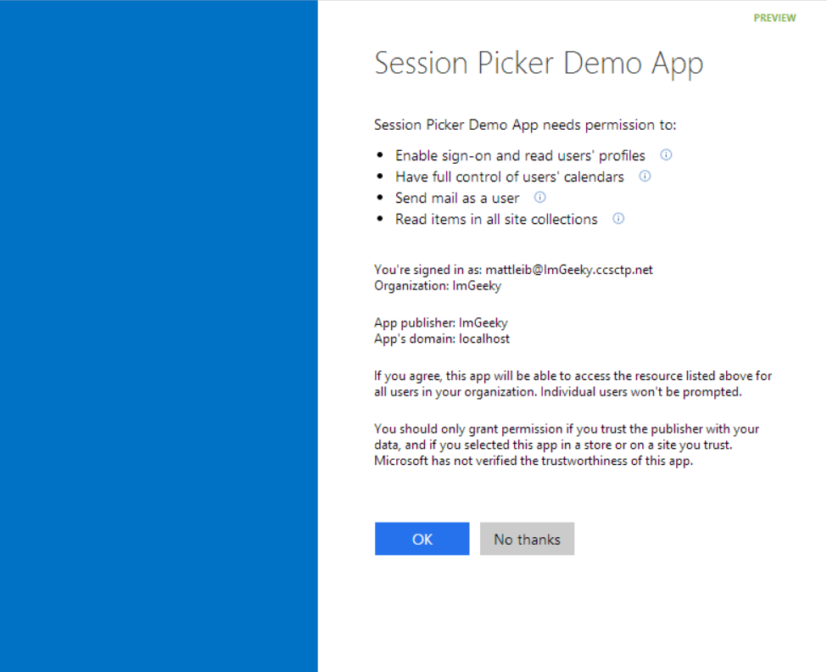
Common Consent

Slide 34
Corporate App Catalog
Secure access to internal apps
Centrally managed repository of private apps
Direct deployment to employees

Slide 35
Continuous innovation
LAST YEAR
THIS YEAR
THE FUTURE
Apps for SharePoint
Apps for Office
VS tooling
Store and lifecycle
Contextual apps
Compose time apps
Robust Office 365 APIs
Tools and platform
Android and iOS SDK
Adding new endpoints
More APIs (Tasks, Office Graph)
More SDKs
Embracing Open
Integrating platform + Tools
Empowering users
Notes:
Specific talking points on “show some leg:”
Endpoints
Building Apps for Office on the MAC
Filling in Apps in Office Online, Word
Connecting Entities
Adding Entities for feeds and tasks.
Embracing more of O365
Working on tools to help developers navigate between entities, like you see in Pulse (We’re showing this, right?)
Embracing Open
Double-down on open standards, interop, protocols and programming frameworks
Making more open source projects
Contributing to more open source projects
Integrating Platform
Easier to manage apps across Azure and O365
More support from VS for apps across not just SharePoint, but all of O365
Empowering Users
Make it easier for users to build solutions without code
Connect those solutions to enhancement from pro-devs

Slide 36
Setting up your Developer Environment in Office 365

Slide 37
Office 365 Environment
Office
Exchange
SharePoint
OneDrive for Business
Azure Active Directory (AAD)
Notes:
SharePoint Online provides a solid business collaboration platform on which developers can build solutions quickly by using familiar development tools. In addition to in-browser customizations, SharePoint Online supports development with Microsoft SharePoint Designer 2010, Microsoft Visual Studio 2010, and Microsoft Visual Studio Team Foundation Server 2010. SharePoint Online enables you to modify sites directly and deploy code as sandboxed solutions that are run in a protected environment to safeguard the environment from poorly performing or malicious code.
SharePoint Online opens a new arena for developers to create solutions for customers who use the Office 365 service instead of maintaining on-premises servers, or for clients who want to take advantage of hybrid deployments where some data is stored behind the firewall and other data is off-loaded in the cloud.

Slide 38
Office 365 Development Options
 | Apps for SharePoint | Apps for Office | Office 365 APIs
Word Excel |  | Task Pane App Content App
Outlook |  | Mail App | Mail Calendar Contacts
SharePoint | SharePoint-Hosted App Cloud-Hosted App |  | Files Sites
OneDrive for Business |  |  | Files

Slide 39
Office 365 uses Windows Azure
Azure Active Directory (AAD)
Azure Access Control Services (ACS)
Azure Web Sites

Slide 40
Azure Active Directory
Identity and Access Management for the cloud
Can create new directories or manage existing ones in Azure subscription
Used by Office 365 for authentication
Used by Azure for user authentication and application authorization
Notes:
Azure Active Directory is a comprehensive identity and access management cloud solution. It combines core directory services, advanced identity governance, security, and application access management. Azure AD also offers developers an identity management platform to deliver access control to their applications, based on centralized policy and rules.

Slide 41
Azure Access Control Services
Identity and Access Management for the cloud
More generic than AAD
Can create new namespaces in Azure subscription
Used by Office 365 for application authorization
Notes:
Windows Azure Access Control Service (ACS) is a Windows cloud-based service that provides an easy way of authenticating and authorizing users to gain access to web applications and services while allowing the features of authentication and authorization to be factored out of the application code. This facilitates application development while at the same time providing users the benefit of being able to log into multiple applications with a reduced number of authentications, and in some cases only one authentication.

Slide 42
Hosting Options
 | Web Site | Office 365 Site | Windows 8.1
Apps for SharePoint | Cloud-Hosted App | SharePoint-Hosted App
Apps for Office | Task Pane App Content App Mail App
Office 365 APIs | Web Application |  | Windows 8.1 App

Slide 43
Setting up Environments in 365
Sign up for an Office 365 subscription
Create a Developer Site Collection
Sign up for Windows Azure subscription
Link Office 365 AAD to Windows Azure
Make Office 365 user administrator in Windows Azure
Use Visual Studio remotely to develop
All instructions in MSDN: “Set up your Office 365 development environment” (https://msdn.microsoft.com/office/office365/howto/setup-development-environment#bk_CreateAzureSubscription)

Slide 44
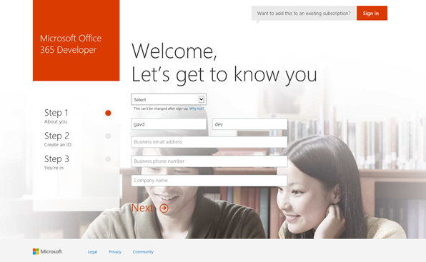
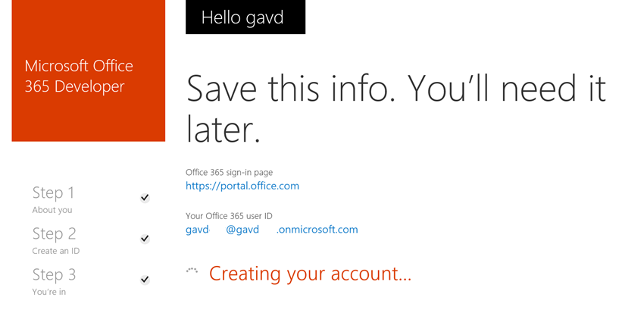
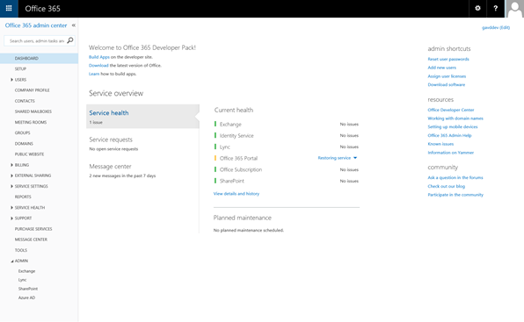
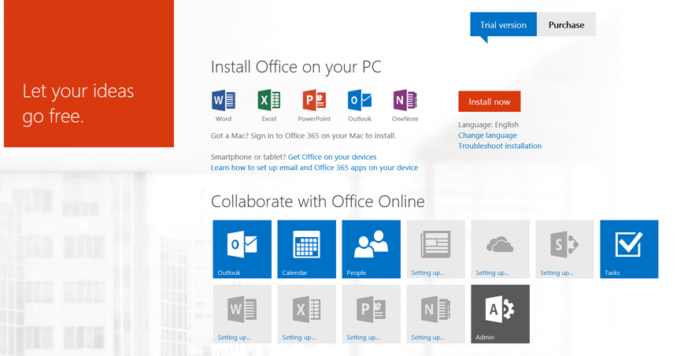
Sign up for an Office 365 subscription
Sign-up
Subscription Administration
Follow instructions
Wait for provisioning

Slide 45
Office Dev Center
Content
Samples
Documentation
Sign up for an Office 365 Developer Site
http://msdn.microsoft.com/en-us/library/office/fp179924(v=office.15).aspx
Notes:
Find how-to content, sample code, SDK and API documentation, VBA references, training, and articles for developing solutions and customizing Office applications and SharePoint products and technologies, including client applications, services, tools, and technologies such as apps for Office, apps for SharePoint, Access, Excel, Exchange, Lync, SharePoint Server, SharePoint Foundation, Skype, and Word.
Use an Office 365 Developer Site as a development and testing environment to shorten your setup time and start creating, testing, and deploying your apps for Office and SharePoint. Deploy the "Napa" Office 365 Development Tools to this preconfigured SharePoint site and you also get a head start on developing SharePoint-hosted apps, and apps for Office documents and mail items, without installing Visual Studio 2012 and Office Developer Tools for Visual Studio 2013 on your development computer. With an Office 365 Developer Site, you get an isolated app domain for SharePoint-hosted apps, preconfigured to use OAuth, so that you can use the Microsoft Azure Access Control Service (ACS) for authenticating and authorizing provider-hosted apps for SharePoint that are deployed to this site.

Slide 46
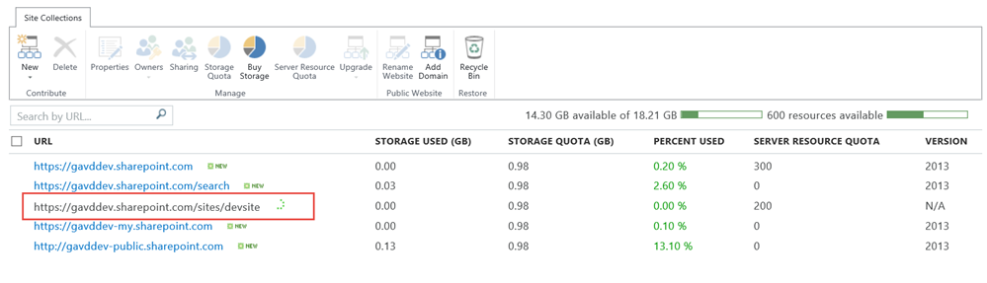
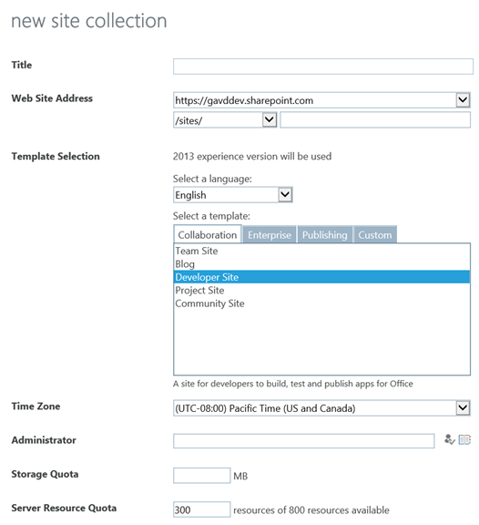
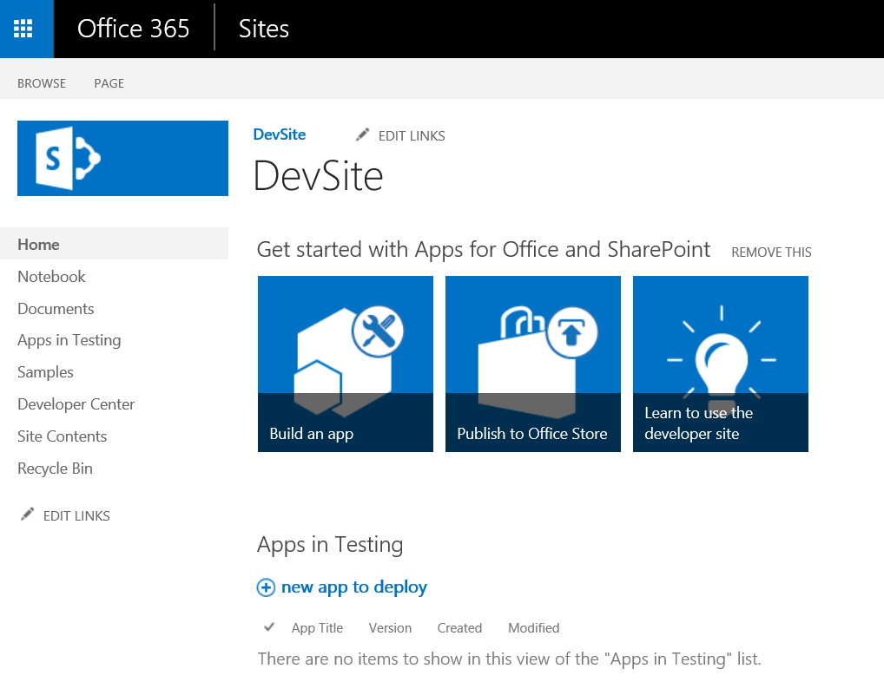
Developer Site Collection
Required for remote app development
Created automatically if you sign up for an Office 365 Developer Site
Use the Developer Site template to create a new Site Collection in an existing tenancy
Notes:
An Office 365 Developer Site makes it easier to get set up and start creating, testing, and deploying your apps for Office and SharePoint more quickly. Office 365 enterprise (E3 or E4) subscriptions include a site template you can use to create a Developer Site.

Slide 47
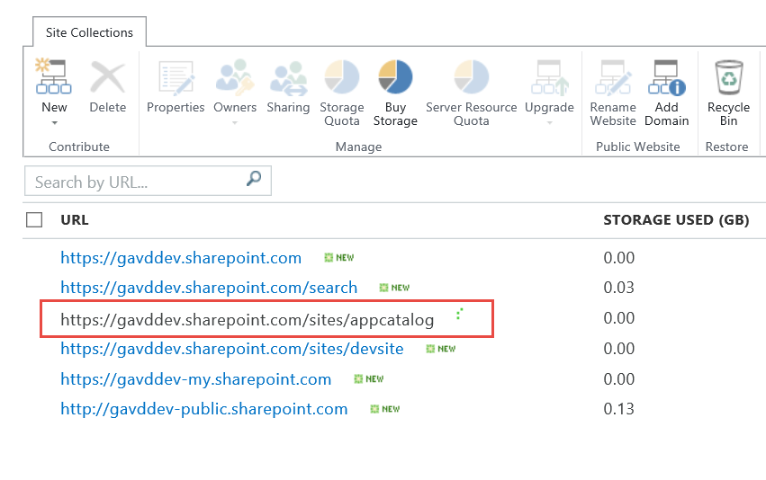
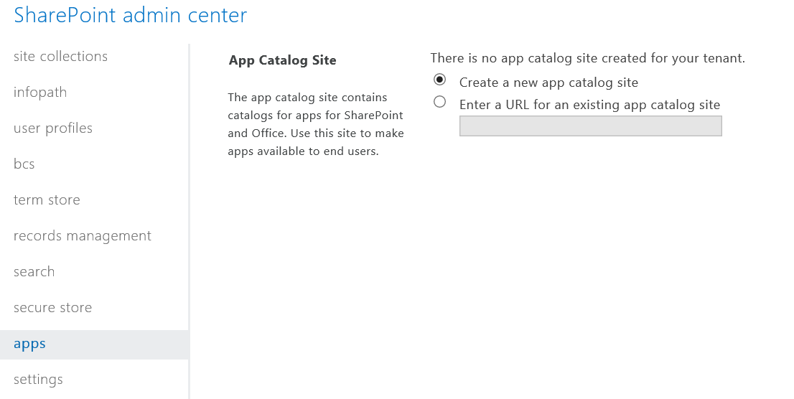
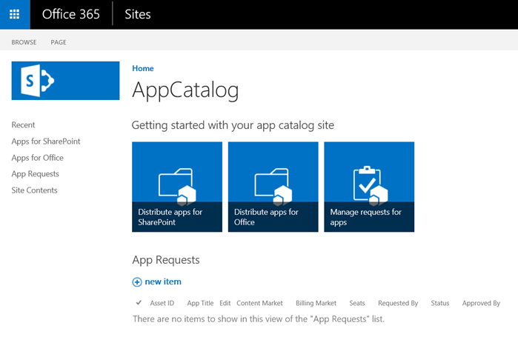
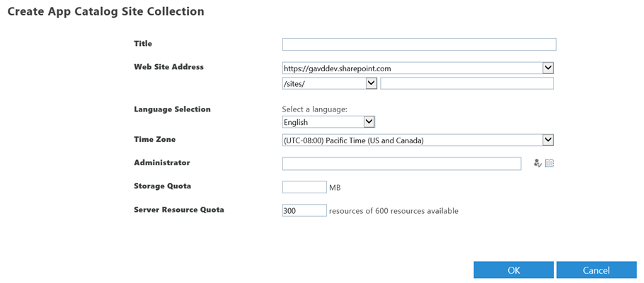
App Catalog
Required to publish apps
Create in the SharePoint Admin Center → Apps → App Catalog → Create a new app catalog site
Notes:
As a SharePoint Online admin, you can create an App Catalog site to make internally developed custom apps available for users to install when they browse apps under the From Your Organization filter on the Site Contents page. Site owners can then add these apps to customize sites with specific functionality or to display information.
After an App Catalog site has been created, you can use it to upload any custom apps that your organization has developed. Uploading custom apps is not much more complicated than uploading a document to a library and setting some properties. You can also use the App Catalog site to do things like install custom or third-party apps on sites for users (also called app deployment). You can also manage app requests from users.

Slide 48
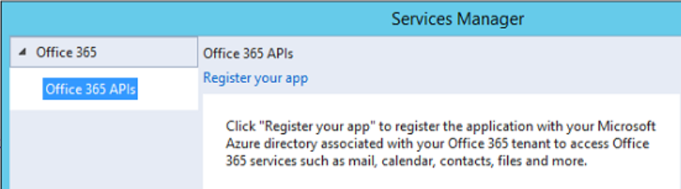
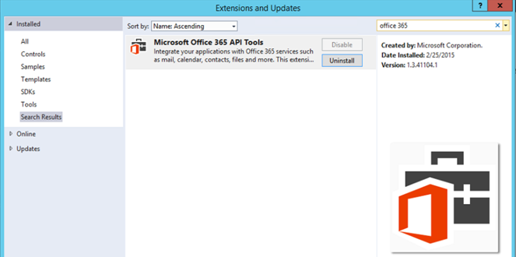
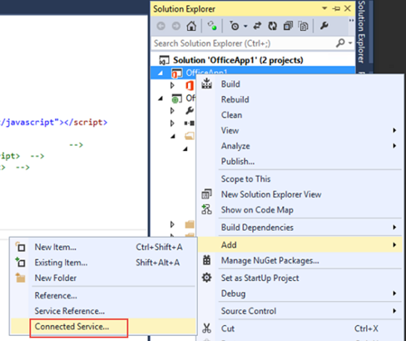
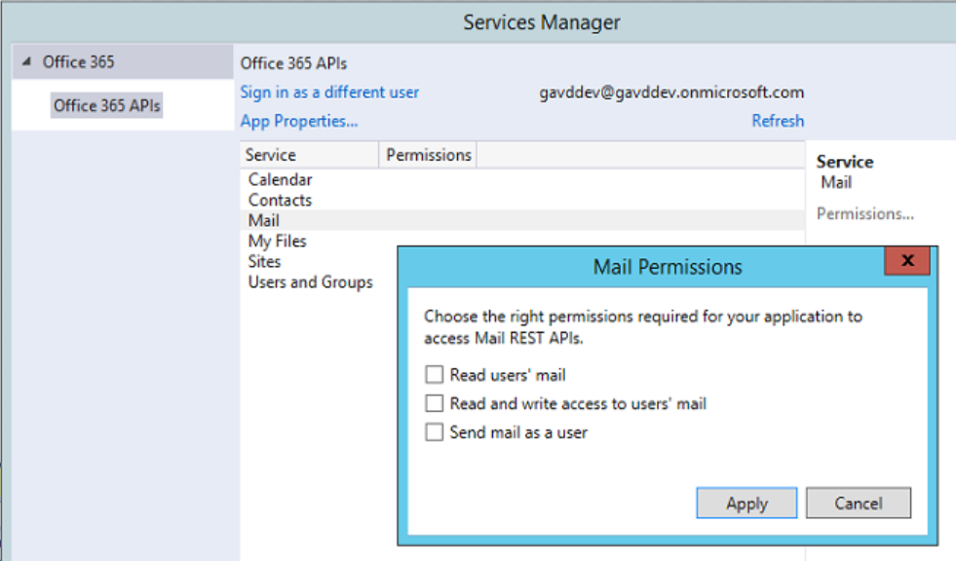
Visual Studio 2013
VS 90-Day Trial http://www.visualstudio.com/en-us/downloads/download-visual-studio-vs.aspx
Office 365 API Tools https://visualstudiogallery.msdn.microsoft.com/a15b85e6-69a7-4fdf-adda-a38066bb5155
From VS: Tools → Extensions and Updates → Search for “office 365”

Slide 49
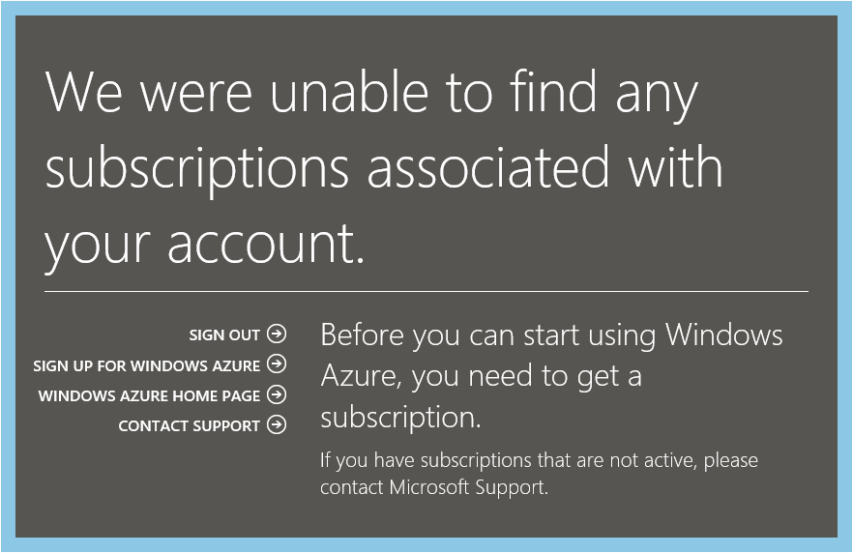
Azure Subscription
Navigate to Azure Portal using Office 365 credentials
When prompted, sign up for a trial

Slide 50
Link Office 365 and Azure
Log into Microsoft Azure subscription as administrator
Click on the Active Directory link.
Click New>Active Directory>Directory>Custom Create
Select to Add an Existing Directory
Follow the steps to add an existing directory
Notes:
It’s not required to link the Office 365 Directory to an Azure subscription
for simply creating provider-hosted apps, but it makes life a bit easier
and opens up the ability to call into Office 365 from other applications.

Slide 51
Office 365 Account as Azure Admin
Log into an existing Microsoft Azure as administrator
Click the Settings link
Click Administrators
Click Add
Add the Organizational Account from Office 365
Notes:
By adding an Office 365 account as an Azure administrator,
you can use a single account for managing both subscriptions

Slide 52
Seller Dashboard

Slide 53
Overview
Required to submit apps to Microsoft marketplaces
Apps for SharePoint
Apps for Office
Windows 8.1
Azure Marketplace
May be company or individual
Notes:
If you are a software developer who creates apps that support or enhance Microsoft technologies, such as Microsoft SharePoint, Microsoft Office, and Azure, you can use the Seller Dashboard to submit and distribute your apps to Microsoft marketplaces.

Slide 54
Sign Up Process
Obtain a Microsoft account, if you do not have one
Sign into the Seller Dashboard with your Microsoft Account
http://go.microsoft.com/fwlink/?LinkId=248605
Fill in the registration information
Submit for approval

Slide 55
Publishing Process
Build the app
Upload app to your Seller Dashboard account
Submit app for approval
See app in the marketplace
Track app usage and receive payout

Slide 56
Setting up your on-premises environment for app development

Slide 57
SharePoint OnPrem dev environment
Creating a SharePoint 2013 VM
Configuring Support for SP Apps
Configuring S2S authentication
Configuring OAuth2 for on Premises
Notes:
What new APIs are available, in preview, in the Office 365 Platform
How to use these API’s in your platform of choice
Some sample business scenarios for leveraging these API’s
Level: Intermediate
Audience: Developer Essentials

Slide 58
Creating a SharePoint 2013 VM

Slide 59
On-premises Setup Overview
Steps
Create a new VM using a VM product such as Hyper-V
Install Windows Server, Active Directory and SQL Server
Install SharePoint Server 2013 with SP1
Install Visual Studio 2013 and update tools
Install Office 2013 with SP1
Configure support for SharePoint apps
Configure S2S authentication
Configure support for OAuth using Windows Azure ACS

Slide 60
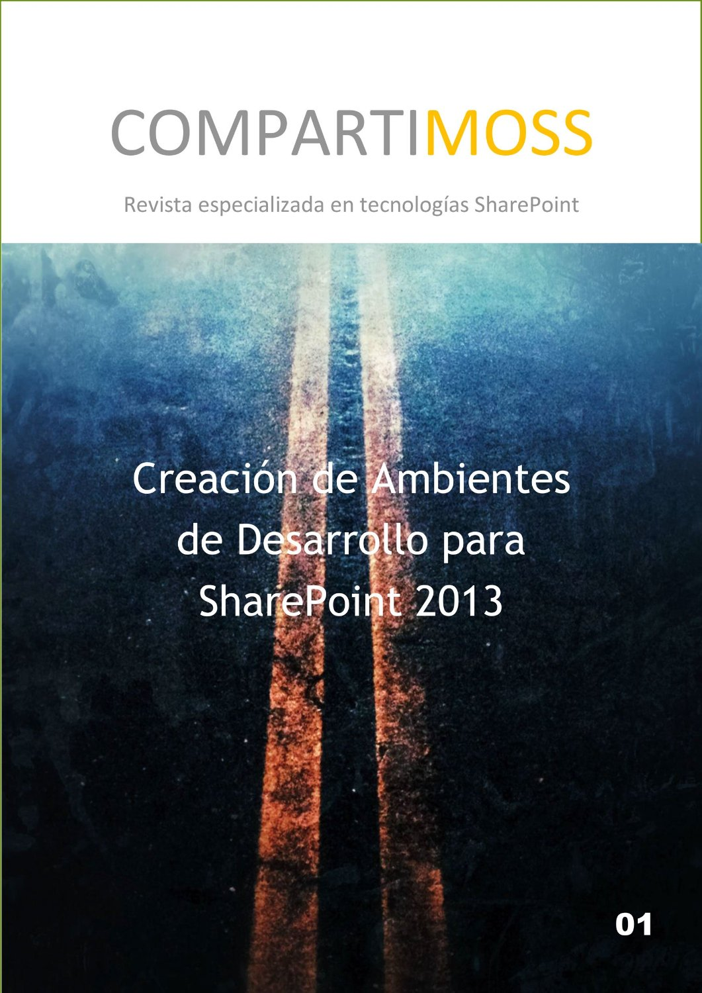
Available Resources
Install and configure SharePoint 2013
http://technet.microsoft.com/en-us/library/cc262957.aspx
SharePoint Server 2013 Virtual Machine Setup Guide
https://www.criticalpathtraining.com/articles/critical-path-training-sharepoint-server-2013-virtual-machine-setup-guide/
Creacion de Ambientes de Desarrollo para
SharePoint 2013
http://www.amazon.com/Ambientes-desarrollo-para-SharePoint-2013-ebook/dp/B00TWO2XW8/ref=sr_1_1?ie=UTF8&qid=1425227676&sr=8-1&keywords=compartimoss

Slide 61
Configuring Support for SharePoint Apps

Slide 62
Service Application Support for Apps
App support requires two service applications
App Management Service
Site Subscription Management Service
These services must be created in on-premises farms to support apps
SharePoint 2013 Farm
SharePoint Tenancy
App Management Service
App Instance Metadata
App Security Principals
App Permissions
App Licensing
Site Collection
Site
App
Site Subscription Settings Service
Tenancy Management
Site Collection Mapping
Notes:
The App Management Service is what manages the installation of apps. Any time an app is installed, SharePoint calls to the App Management Service which updates its database with metadata for the app to track various aspects of the app such as the app’s start page URL and security information for app authentication.
The Site Subscription Management Service is used by the SharePoint host environment to track tenancies. In the Office 365 environment, each customer is assigned its own tenancy. However, in on-premises farms the vast majority of SharePoint customers do not manage their site collections using tenancies. However, an on-premises farm still requires the Site Subscription Manage Service to be created. You can create an instance of the Site Subscription Manage Service in an on-premises farm using the following PowerShell script. Simply creating the service will create a single farm-wide default tenancy which meets the requirements for installing and running SharePoint apps. Note that the script shown here is also available in the Demo folder for this module under the name of CreateSubscriptionSettingsService.ps1 if you want to open it up and examine it.
# load in SharePoint snap-in
Add-PSSnapin Microsoft.SharePoint.PowerShell -WarningAction SilentlyContinue
# assign root domain name to configure URL used to access app webs
Set-SPAppDomain "apps.wingtip.com" –confirm:$false
$subscriptionSettingsService = Get-SPServiceInstance |
where {$_.TypeName -like "Microsoft SharePoint Foundation Subscription Settings Service"}
if($subscriptionSettingsService.Status -ne "Online") {
Write-Host "Starting Subscription Settings Service"
Start-SPServiceInstance $subscriptionSettingsService | Out-Null
}
# wait for subscription service to start
while ($service.Status -ne "Online") {
# delay 5 seconds then check to see if service has started sleep 5
$service = Get-SPServiceInstance |
where {$_.TypeName -like "Microsoft SharePoint Foundation Subscription Settings Service"}
}
$subscriptionSettingsServiceApplicationName = "Site Subscription Settings Service Application"
$subscriptionSettingsServiceApplication = Get-SPServiceApplication |
where {$_.Name -eq $subscriptionSettingsServiceApplicationName}
# create an instance Subscription Service Application and proxy if they do not exist
if($subscriptionSettingsServiceApplication -eq $null) {
Write-Host "Creating Subscription Settings Service Application..."
$pool = Get-SPServiceApplicationPool "SharePoint Web Services Default"
$subscriptionSettingsServiceDB= "Sharepoint_SiteSubscriptionSettingsServiceDB"
$subscriptionSettingsServiceApplication = New-SPSubscriptionSettingsServiceApplication `
-ApplicationPool $pool `
-Name $subscriptionSettingsServiceApplicationName `
-DatabaseName $subscriptionSettingsServiceDB
Write-Host "Creating Subscription Settings Service Application Proxy..."
$subscriptionSettingsServicApplicationProxy = New-SPSubscriptionSettingsServiceApplicationProxy `
-ServiceApplication $subscriptionSettingsServiceApplication
}
# assign name to default tenant to configure URL used to access web apps
Set-SPAppSiteSubscriptionName -Name "WingtipTenant" -Confirm:$false

Slide 63
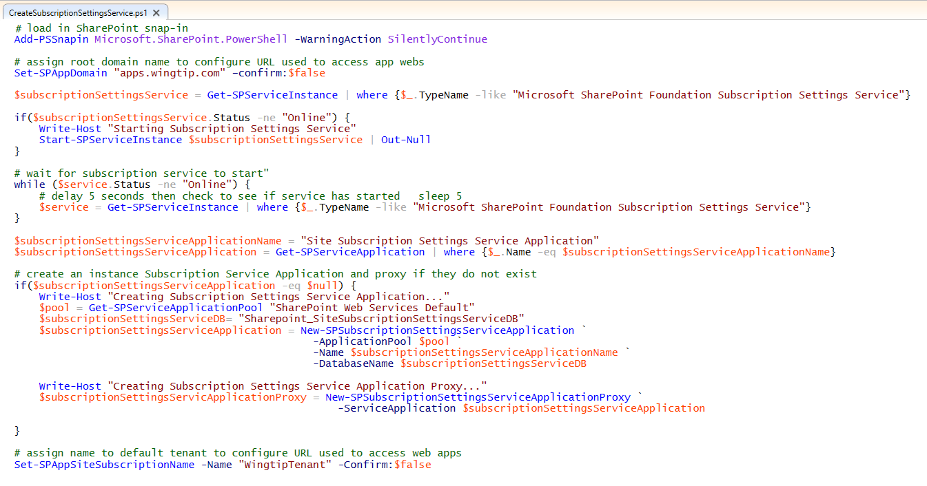
Configuring Support for Apps

Slide 64
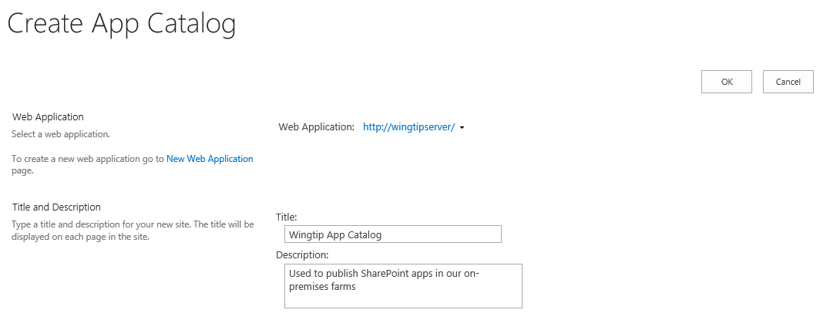
Creating the App Catalog Site Collection
You must create the App Catalog site collection
You can create it using a PowerShell script
You can create it using Central Administration
App Catalog site associated with one web application

Slide 65
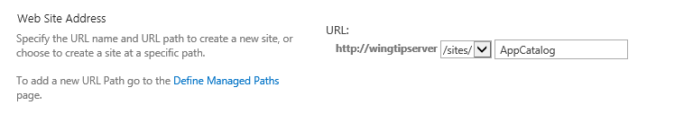
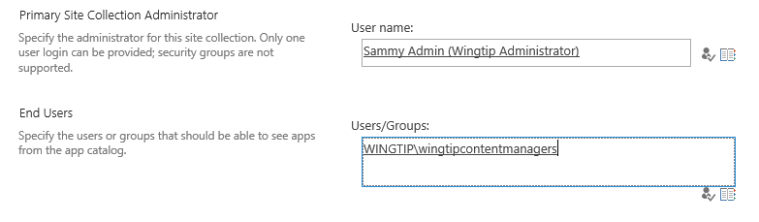
App Catalog URL and Permissions
App catalog site created at a specific URL
Creating App Catalog site with PowerShell is more flexible you can create site as top-level domain using host-named site collections (HNSCs)
Setting App Catalog permissions
Site collection administrator becomes App Catalog administrator
End user permissions allows user to discover and install apps

Slide 66
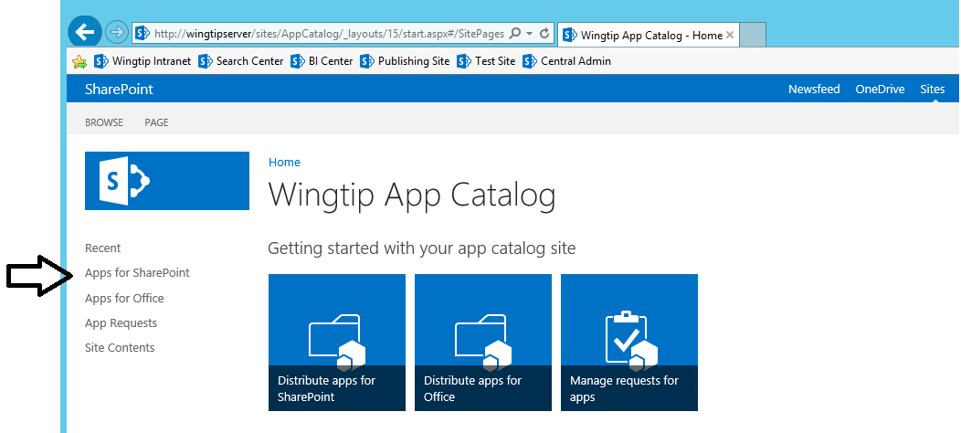
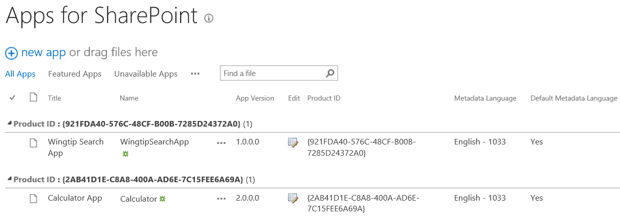
Apps for SharePoint Document Library
Apps for SharePoint is special document library
It's the place where you publish SharePoint apps
You upload app package and enter the related metadata

Slide 67
Configuring S2S authentication

Slide 68

What is a Server-to-server (S2S) Trust
Trusted connection between app and SharePoint
Eliminates need for ACS (Azure Access Control Service) when running apps in on-premises farm
Trust between servers configured using SSL certificates
App code requires access to private key of SSL certificate
Requires creating Security Token Service on SharePoint server(s)
Las aplicaciones High-Trust – I (Edin Kapic) - CompartiMOSS http://www.compartimoss.com/revistas/numero-22/las-aplicaciones-high-trust-i
Private Network Environment
SharePoint Web Server
S2S STS
1
User
3
4
2
Client App
SSL Cert
Public/Private key pair (.pfx)
Notes:
SharePoint 2013 makes it possible for Web servers in a SharePoint farm to a client app requests using a server-to-server (S2S) trust. This type of configuration can be used when deploying developer-hosted apps in a private network when it is beneficial to avoid any dependencies on ACS or any other servers running across the Internet. That means that all the servers involved can run behind a single firewall and on the same local area network.
A S2S trust represents a trusted connection between a client app running on a local app server and the Web servers in the SharePoint farm. Configuring the trust requires an SSL certificate which is based on the URL with the DNS name (e.g https://appserver.wingtip.com) where the client app is located. The client app contains code which has access to the private key associated with the SSL certificate and it uses this private key to sign security tokens. On the SharePoint Web Server, you must create a security token service which can use the public key to authenticate and decrypt these security tokens generated by the client app.

Slide 69
S2S with on-premises
Approve and Publish Apps
Server Admin
3
App Admin
Registration of certificates
1
2
Configuration of certificates
SharePoint Service
Provider hosted Apps
7
Remote connectivity
Verification of certificate
6
spapp_appname.contoso.com
5
4
End users

Slide 70
Configuring a Server-to-Server Trust
Steps to configure an S2S trust
Create an x509 certificate
Make certificate’s public key accessible to SharePoint
Use PowerShell to create a trusted security token issuer based on public key
Develop provider-hosted app which has access to private key file
Create S2S access tokens with the help of TokenHelper class
Pass access token with calling into SharePoint using CSOM or REST API
Two ways to make a certificate available
Pass file path of certificate to SharePoint
Expose certificate from app as metadata endpoint

Slide 71
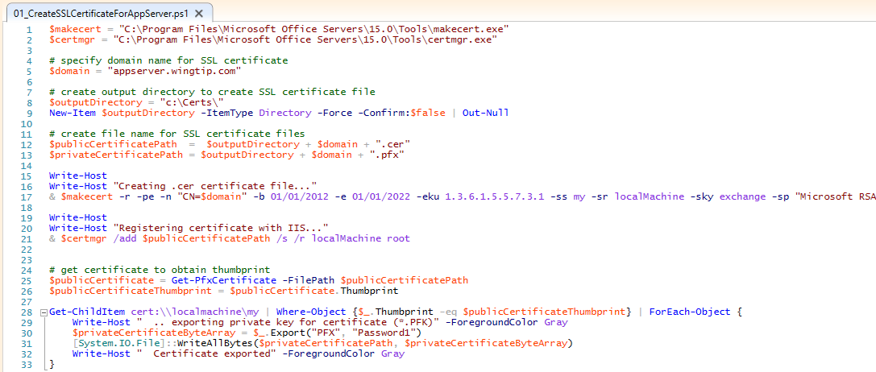
Creating Certificates
Notes:
This is an example of a PowerShell script that creates a self-signed SSL certificate for an app running at the DNS name of http://appserver.wingtip.com. The self-signed certificate is made by calling the makecert.exe utility. Note that the script creates the self-signed certificate with a private key. This certificate is then installed into the certificate store on the local machine using the certmgr.exe utility. The code at the bottom of the script shows how to enumerate through the SSL certificates stored on the local machine and to find those that have private keys. The call to Export is what produces a private key file that is signed with the password of Password1.

Slide 72
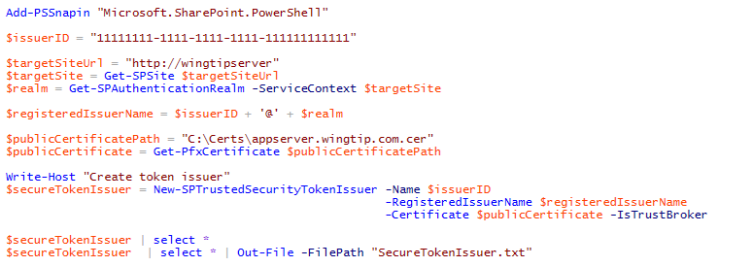
Creating the Secure Token Issuer
Steps to creating security token issuer in SharePoint farm
Get the authentication realm (aka tenancy)
Create realm-qualified app identifier
Create certificate object using .pfx file containing password-protected private key
Call New-SPTrustedSecurityTokenIssuer
Notes:
To configure an S2S high trust connection in an on-premise SharePoint farm, you must use Windows PowerShell and SharePoint 2013 cmdlet named New-SPTrustedSecurityTokenService. When you call the New-SPTrustedSecurityTokenService cmdlet ou mus pass it a string-based name and the URL to the metadata discovery endpoint for the app. SharePoint then uses the metadata in the JSON token returned from the metadata discovery endpoint to properly create the new STS configured with the correct public key.
After creating the S2S trust between the client app and the SHarePoint Web servers, it is then required to register one on more app principals using the Register-SPAppPrincipal cmdlet. Note that app principals are scoped to a tenancy. If all the sites in the on-premise local farm are running within the default tenancy, you can create a single farm-wide app principal.
Once you have create the app principal, you can then assign permissions to it using the Set-SPAppPrincipalPermission cmdlet.

Slide 73
App Principals
External authentication requires app principals
App principal is a tenancy-scoped account for app identity
App principal identified using a GUID
App principals must be created in SharePoint host
App principal properties
Client ID: GUID-based identifier for app principal
Client Secret: (not used in S2S)
App Host Domain: Base URL of remote web
Redirect URL: URL to a page used to configure on-the-fly security

Slide 74
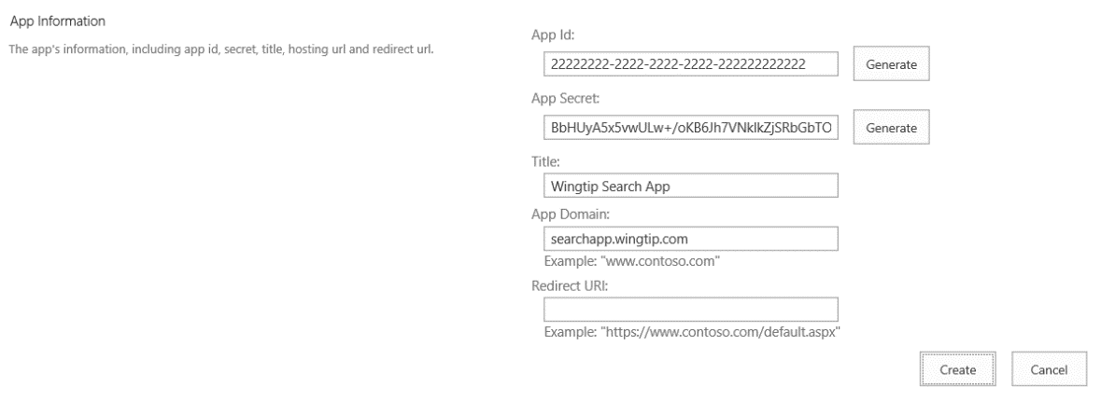
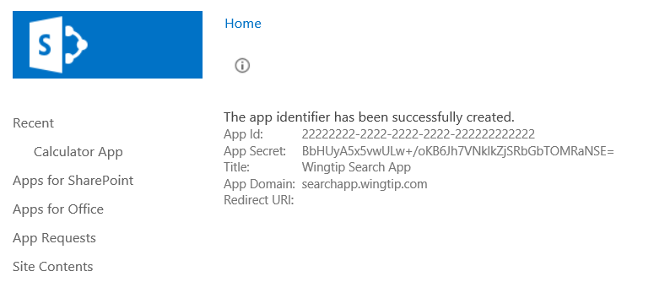
Registering an App Security Principal
Done automatically by Visual Studio during development
When you press {F5}, VS automatically registers app principal
Visual Studio also updates web.config file
Can also be done using AppRegNew.aspx page
App deployment covered in more detail in App Publishing module

Slide 75
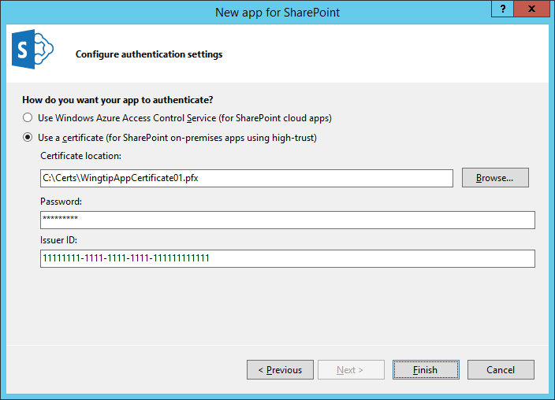

Configuring the S2S Certification in VS
Visual Studio provides two app authentication options
Use Windows Azure Access Control Service (this means OAuth)
Use a certificate (this means S2S)

Slide 76

App Manifest during Development

Slide 77

App Manifest in Real-world Deployment

Slide 78
Configuring OAuth2 for on Premises

Slide 79
Windows Azure Environment
Azure Active Directory (AAD)
Azure Access Control Services (ACS)
Azure Web Sites

Slide 80
Azure Active Directory
Identity and Access Management for the cloud
Can create new directories or manage existing ones in Azure subscription
Used by O365 for authentication
Used by Azure for user authentication and application authorization
Notes:
Azure Active Directory is a comprehensive identity and access management cloud solution. It combines core directory services, advanced identity governance, security, and application access management. Azure AD also offers developers an identity management platform to deliver access control to their applications, based on centralized policy and rules.

Slide 81
Azure Access Control Services
Identity and Access Management for the cloud
More generic than AAD
Supports additional providers Google, Yahoo, Facebook
Can create new namespaces in Azure subscription
Used by O365 for application authorization
Notes:
Windows Azure Access Control Service (ACS) is a Windows cloud-based service that provides an easy way of authenticating and authorizing users to gain access to web applications and services while allowing the features of authentication and authorization to be factored out of the application code. This facilitates application development while at the same time providing users the benefit of being able to log into multiple applications with a reduced number of authentications, and in some cases only one authentication.

Slide 82
ACS with on-premises
1
Provider hosted Apps
App Admin
Register App
Retrieve Token
5
2
Approve and Publish
Remote
connectivity
4
SharePoint Service
Verification of registration
7
6
3
End users

